Slide 1


Slide 2
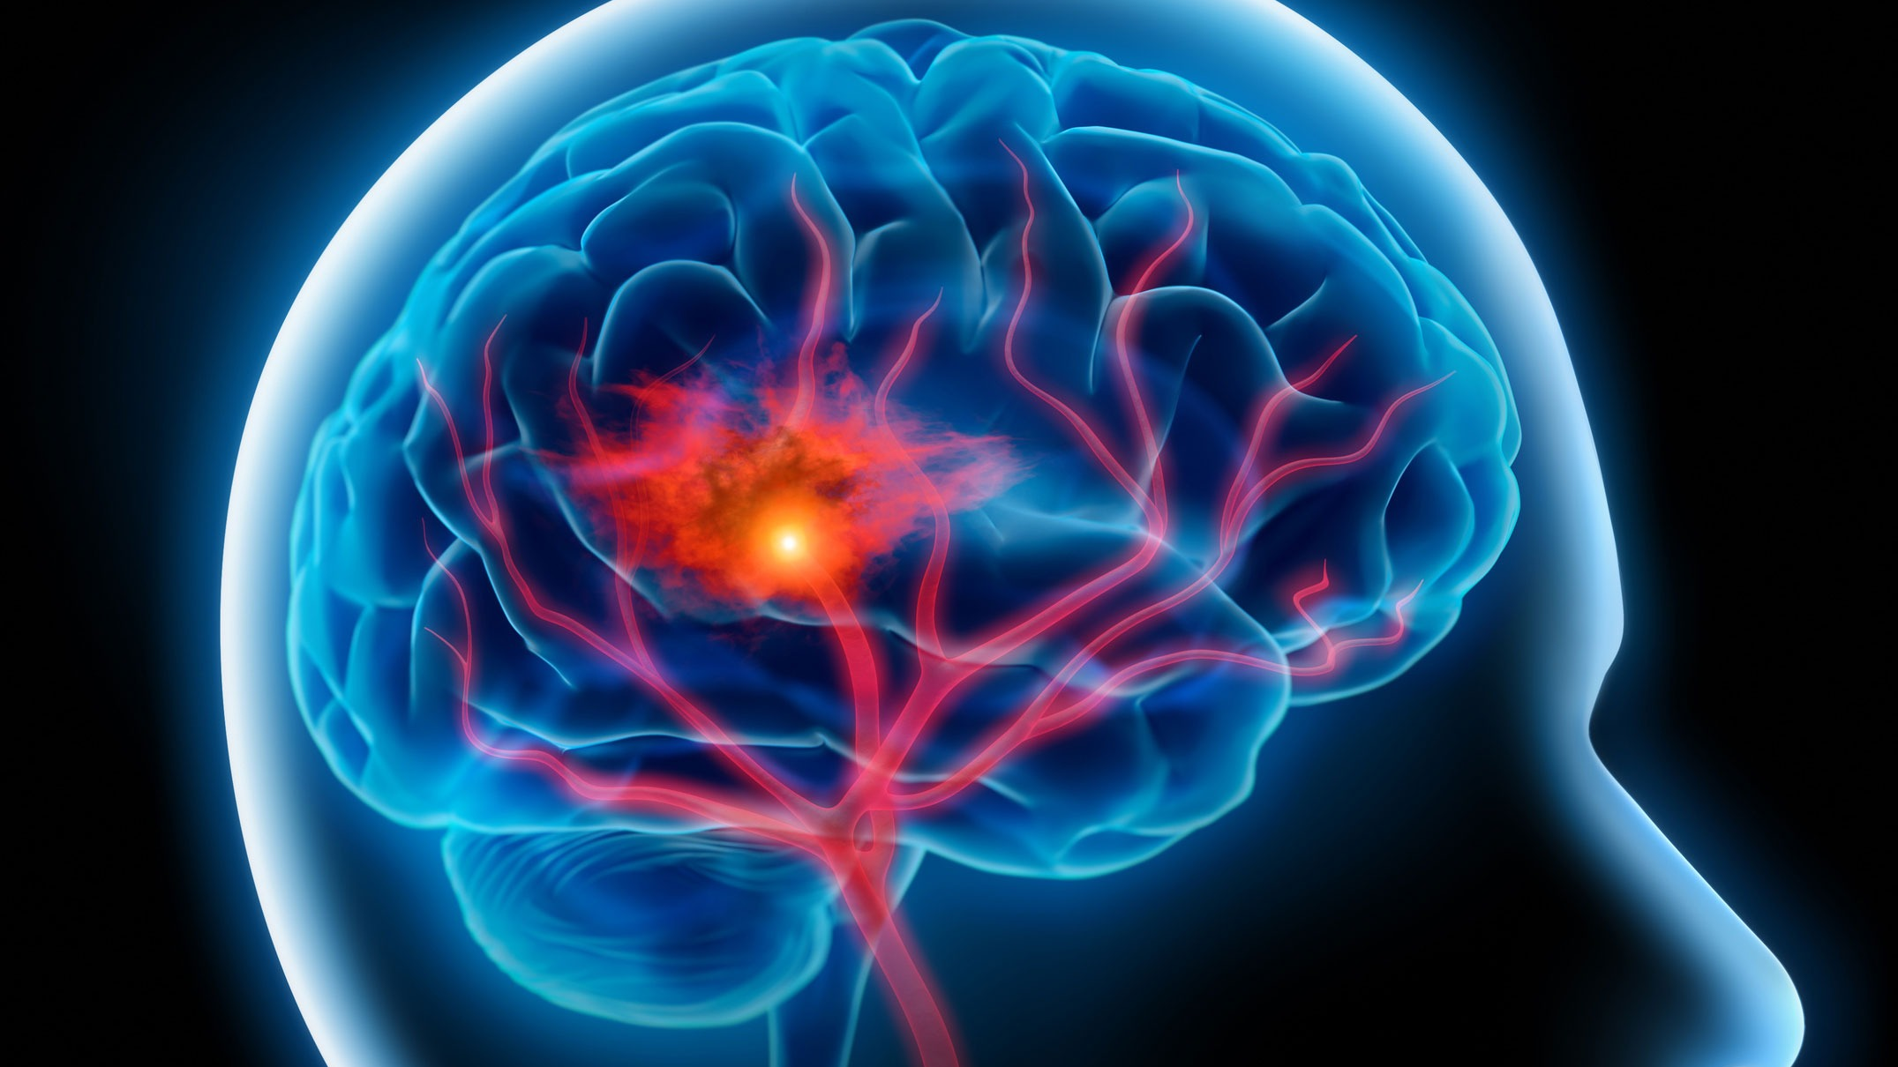
Topic : Stroke Prediction
Presented by Mansi Choudhary

Slide 3

Content
Introduction and Problem Statement
Importing libraries
Data Understanding
Data Cleaning
Data Visualization
Data Preprocessing
Model Selection
Model Comparison
Testing
Conclusion

Slide 4
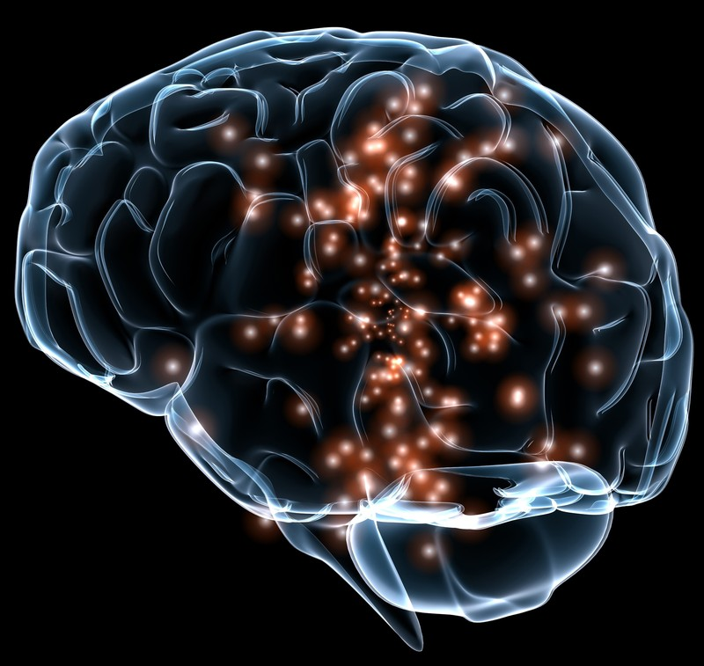
Introduction
According to the World Health Organization (WHO) stroke is the 2nd leading cause of death globally, responsible for approximately 11% of total deaths.
This dataset is used to predict whether a patient is likely to get stroke based on the input parameters like gender, age, various diseases, and smoking status. Each row in the data provides relevant information about the patient

Slide 5

Problem Statement
The goal of this exploratory analysis is to develop an effective model for predicting the likelihood of strokes in individuals within a healthcare dataset

Slide 6




Importing libraries

Slide 7
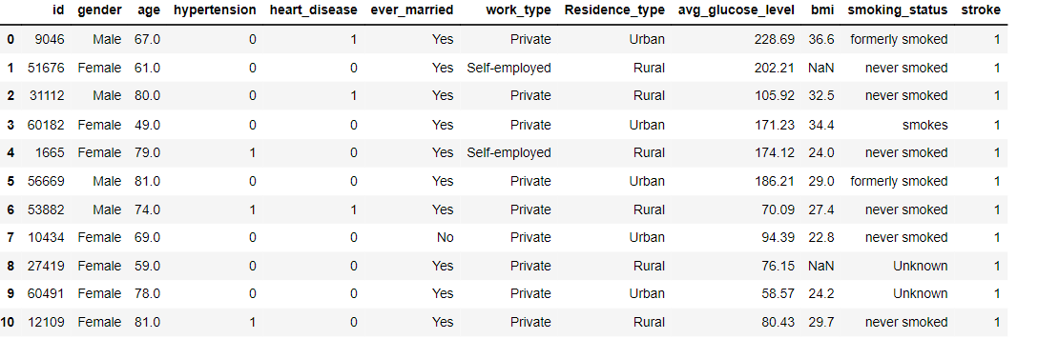
Data Understanding
Displaying Dataset
Data shape

Slide 8
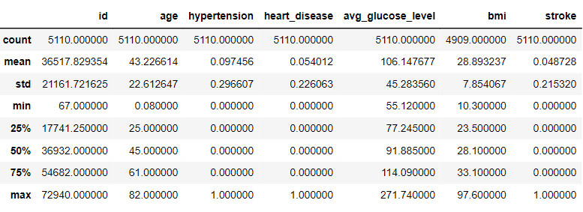
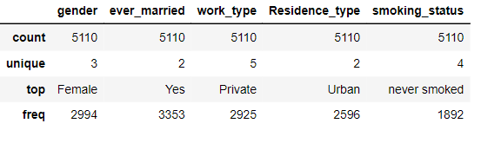
Data Understanding
Description of Numerical data
Description of Categorical data

Slide 9
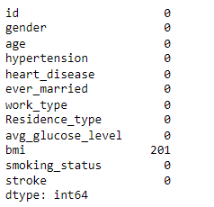
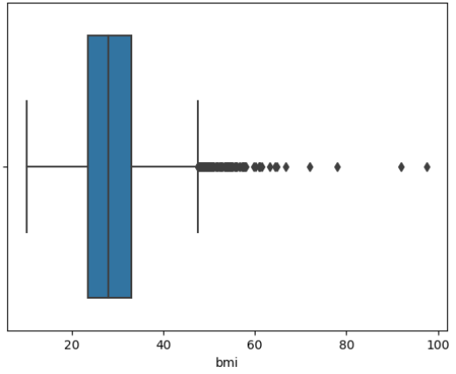
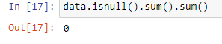
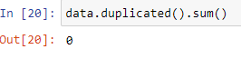
Data Cleaning
Checking null values
After imputation null values
Checking Duplicate Values
Null value filled

Slide 10
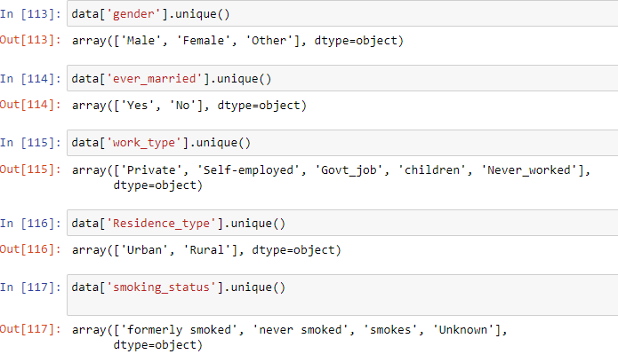
Data Cleaning
Dropped ‘id’ column
Checking spelling mistake and unique values

Slide 11
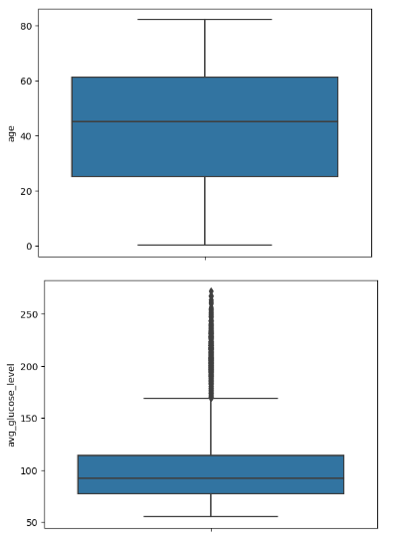
Data Cleaning
Checking Outliers

Slide 12
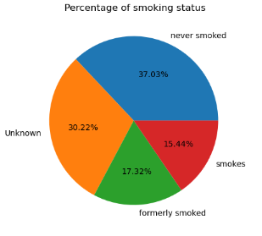
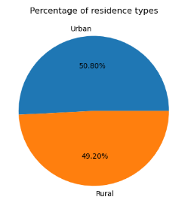
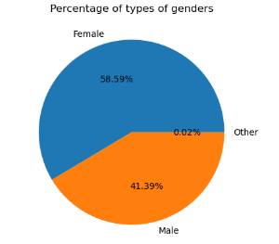
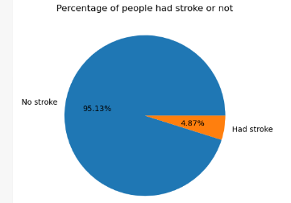
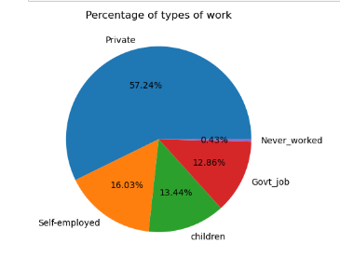
Data Visualization
Analysis for Categorical data

Slide 13
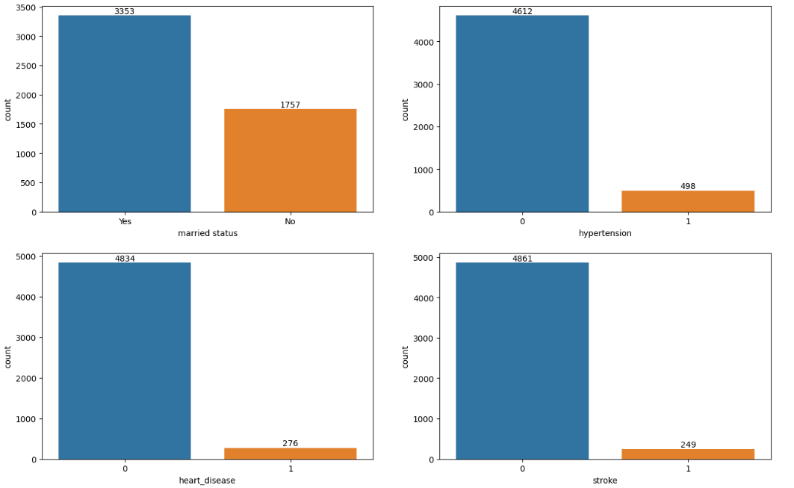
Data Visualization
Analysis for Binary number data

Slide 14
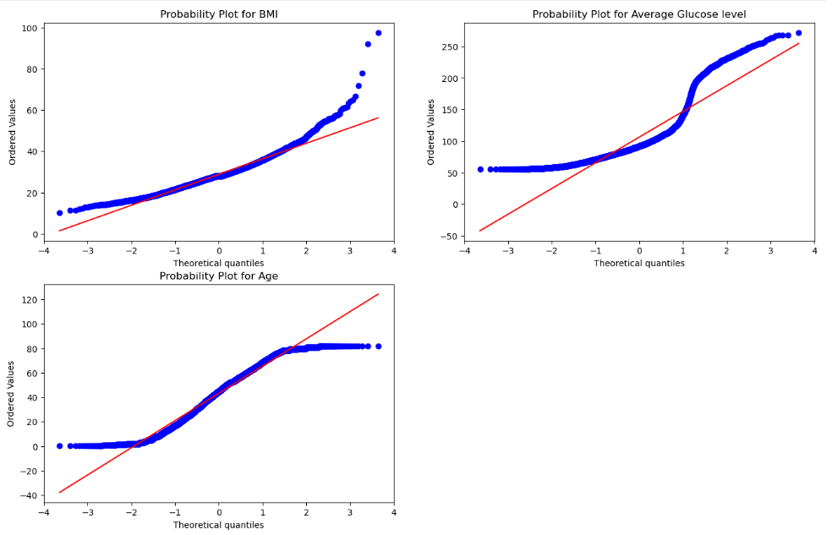
Data Visualization
Data distribution nature

Slide 15
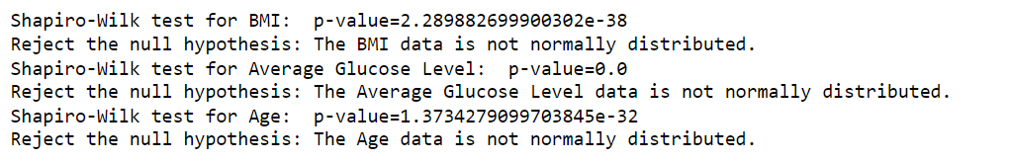
Data Visualization
Hypothesis testing for BMI , Average Glucose
level and age

Slide 16
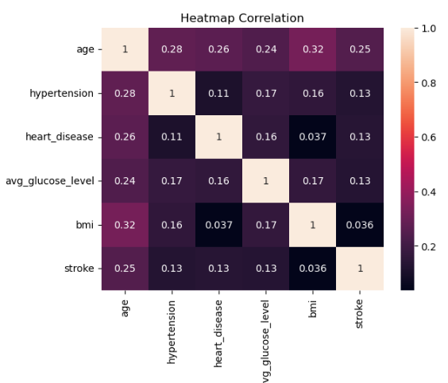
Data Visualization
Age appears to have a notable influence

Slide 17
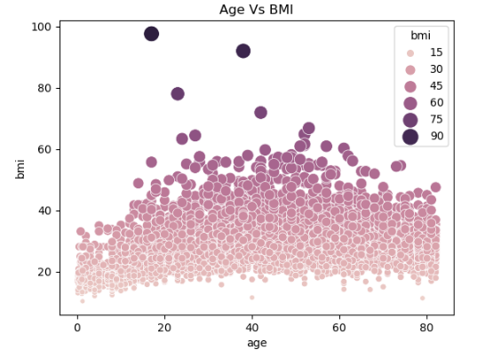
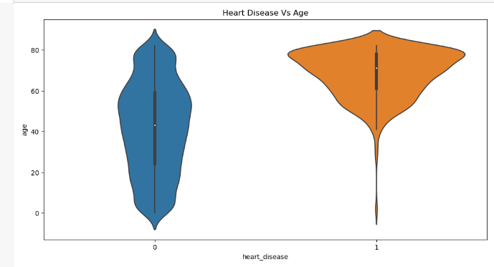
Data Visualization
Aged between 20 to 60
years often exhibit
higher BMI values
Significantly heart
Diseases increases above
the age of 30

Slide 18
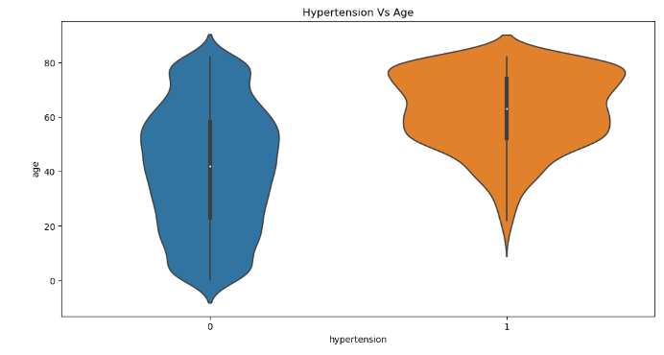
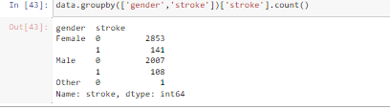
Data Visualization
Significantly hypertension
increase above the age of
20

Slide 19
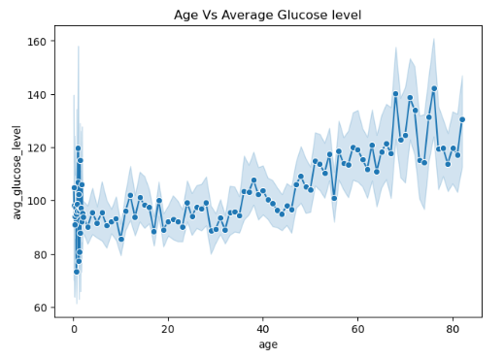
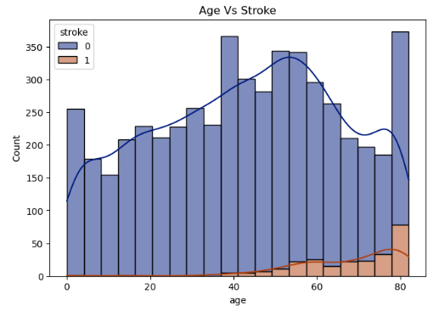
Data Visualization
Patients above age of 40
shows higher average
glucose level
Stroke rate illustrate a
notable rise after the age
of 40

Slide 20
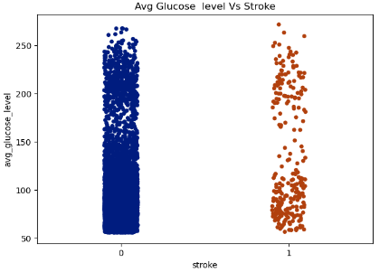
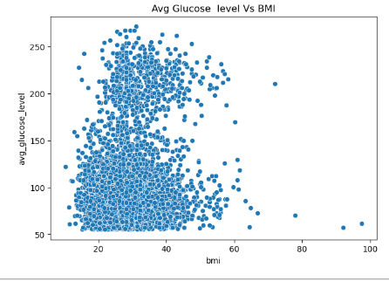
Data Visualization
Stroke patients had either low or high glucose levels
BMI between 40 and 60 exhibit high average glucose levels, while those with a BMI exceeding 60 show low average glucose levels.

Slide 21
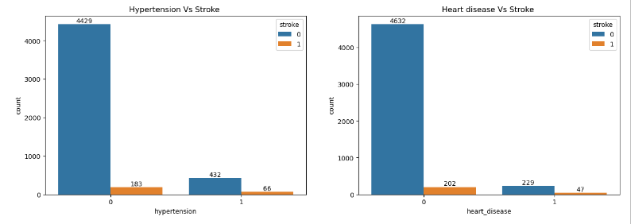
Data Visualization
Despite the absence of heart disease or hypertension,
data reveals that some patients still experienced strokes

Slide 22
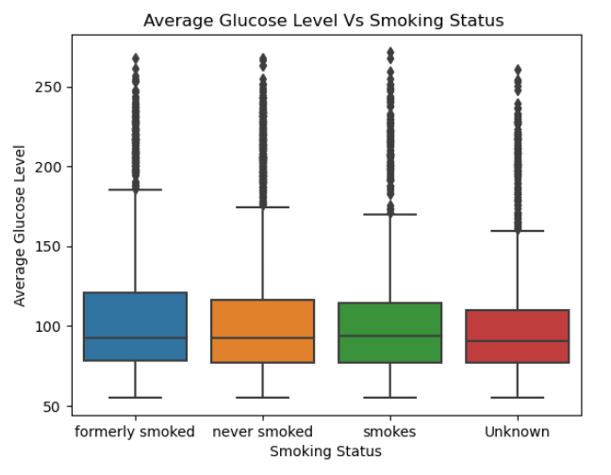
Data Visualization
Formerly smoking individuals have a higher average glucose level.

Slide 23
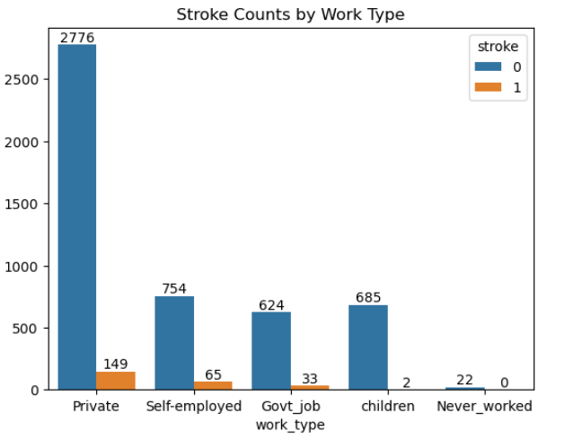
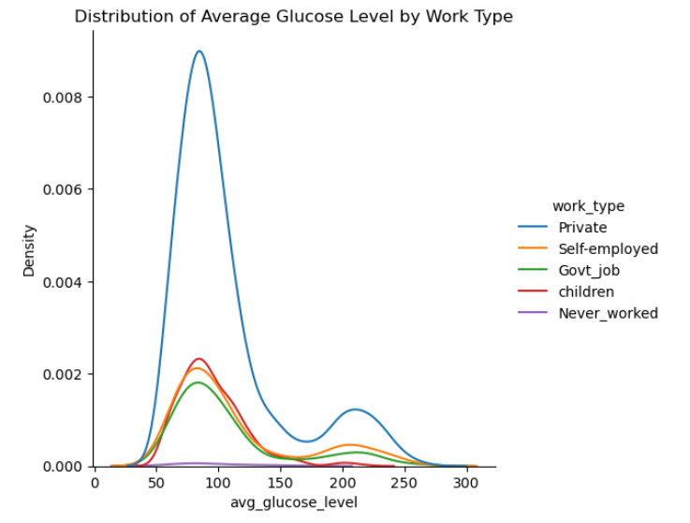
Data Visualization
Private-sector jobs show the highest stroke incidence
Private sector tend to have higher average glucose levels

Slide 24
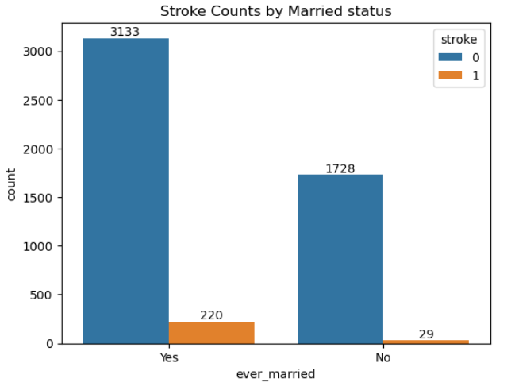
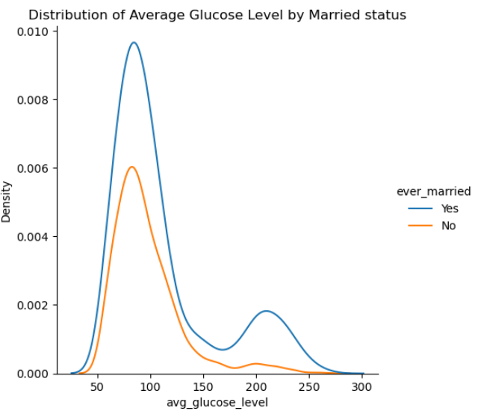
Data Visualization
Married individuals, reporting a higher average glucose level, also experience the highest incidence of strokes

Slide 25
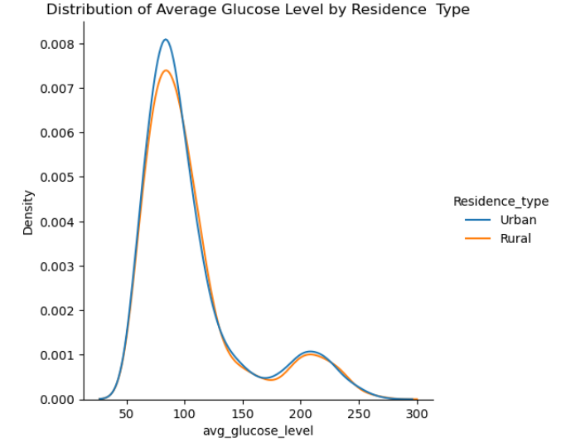
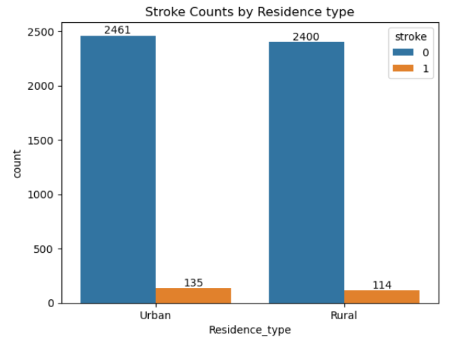
Data Visualization
Urban individuals with slightly higher average glucose levels also experience a slightly elevated stroke incidence compared to rural counterparts

Slide 26
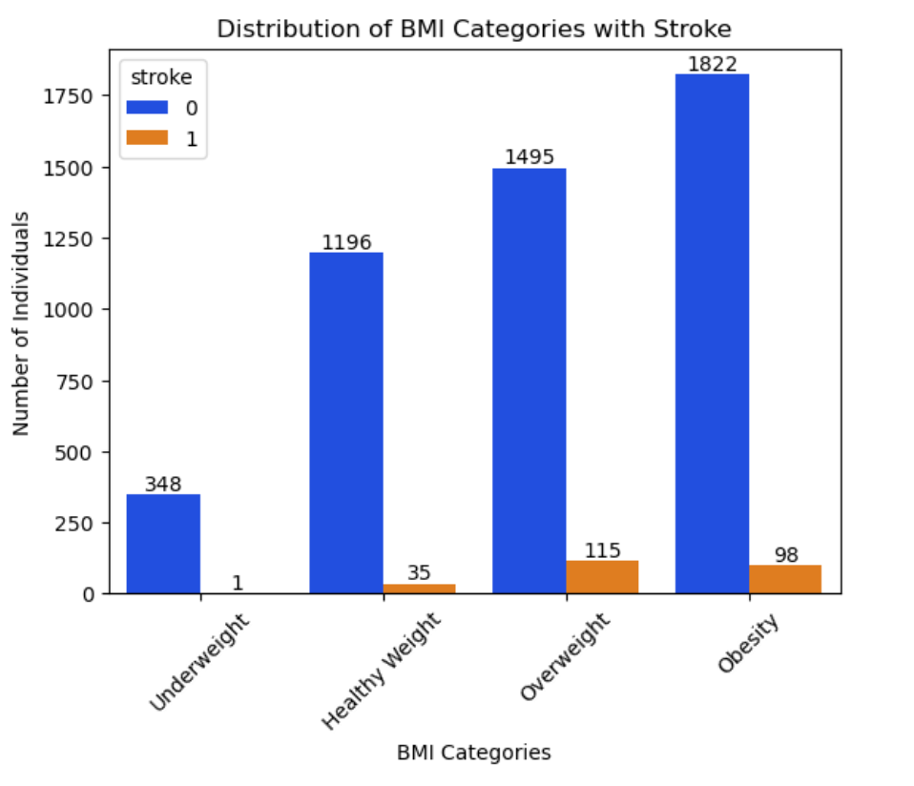
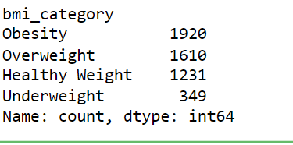
Data Visualization
Binning BMI column
BMI | Weight Status
Below 18.5 | Underweight
18.5—24.9 | Healthy Weight
25.0—29.9 | Overweight
30.0 and Above | Obesity

Slide 27
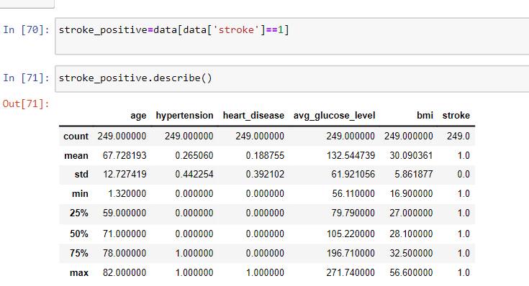
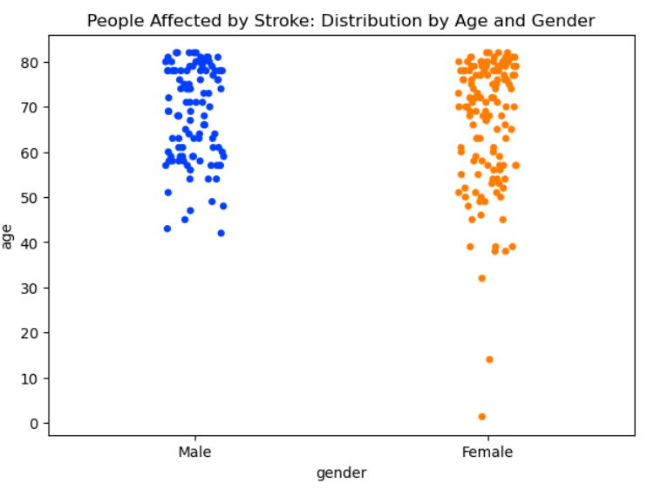
Describing columns based on stroke occurrence

Slide 28


Data preprocessing
Used Label Encoder
Splitting up the data
Feature Scaling
SMOTE

Slide 29
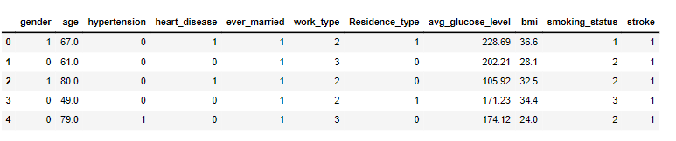
Data preprocessing
Applied Label Encoder
Data Splitting

Slide 30
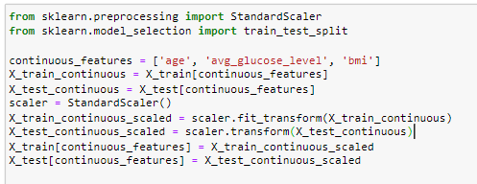
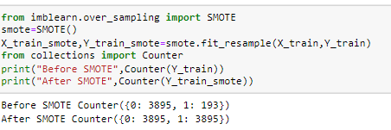
Data preprocessing
Feature Scaling
SMOTE

Slide 31
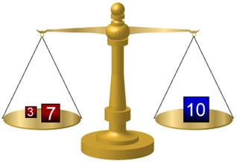
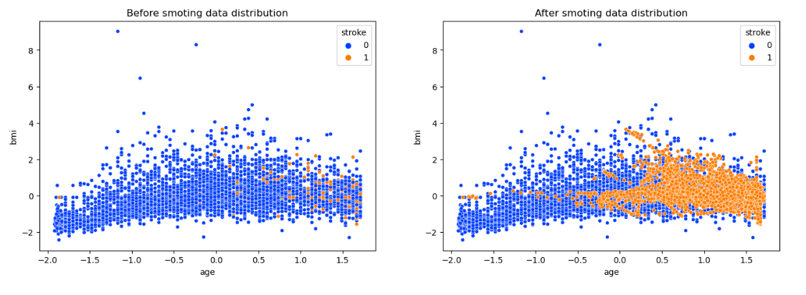
Data preprocessing
SMOTE Visualization

Slide 32
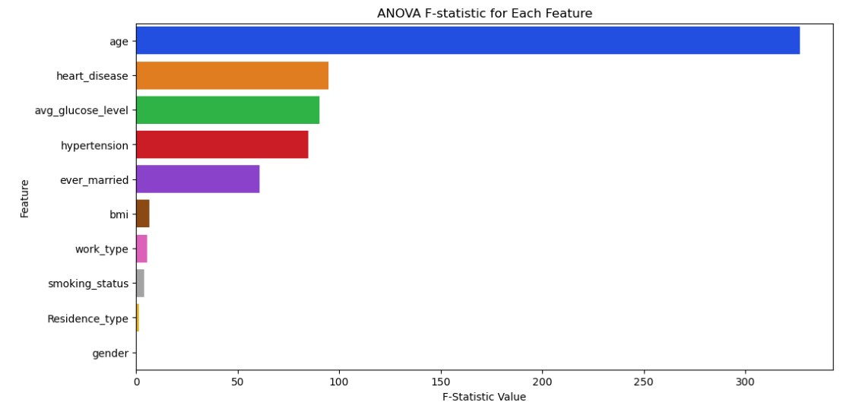
Identifying the best feature
The feature 'age' has the greatest influence among all features

Slide 33
Model Selection
Models
Logistic Regression
K Neighbors Classifier
Decision Tree Classifier
Gaussian Naive Bayes
Random Forest Classifier
Support Vector Classifier

Slide 34
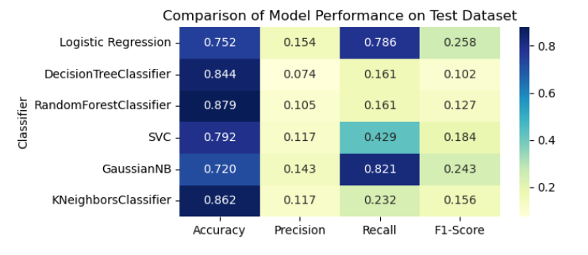
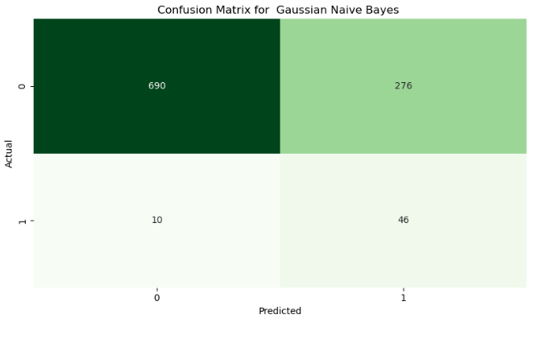

Model Performance
Best Model : Gaussian Naive Bayes

Slide 35
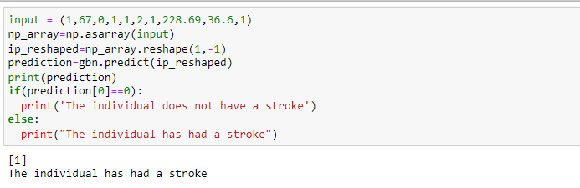

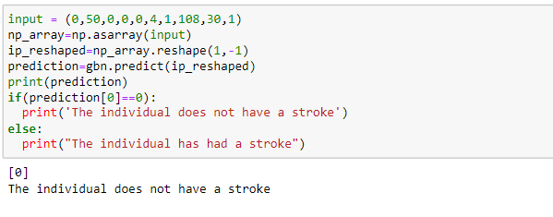
Testing

Slide 36

Conclusion
Most people experience a stroke when they have either a low or high average glucose level
Even when patients don't have hypertension or heart disease, they still experience strokes
As age increases, the likelihood of experiencing a stroke also increases
Private sector has shown a higher number of stroke cases
01
02
03
04

Slide 37
Thank You!!

